Slide 1
Web portal for concentration and flux of CO₂ in global inland waters
Notes:
Include methane and n2o can attract more users.
Include a map interface for people to easily upload and view data.
Do we take csv files or Form upload.
How do you expect the data increment?
How do you expect the longevity of the web-portal?
Computing scale
Perhaps can also have stream network included in the database

Slide 2
Idea
NASA funded project (estimating CO₂ emission from global rivers) (PI: Pete Raymond, David Butman)
Old estimation: Raymond, P. A. and others 2013. Nature 503: 355-359.
Real CO₂ measurements versus CO₂ calculated from pH and alkalinity
Now: 6000 real measurements from 1000+ sites
Encourage data sharing within the community
Example web application: http://portal.goa-on.org/Explorer

Slide 3
UPLOAD DATA
MAP INTERFACE
Excel file
Batch Upload
VIEW DATA
CO₂
DOWNLOAD DATA
Filter by
Location
Date Range
Adjust Symbol Size
Choose Color Ramp
Gas Type
Color Ramp
…
Min
Max

Slide 4
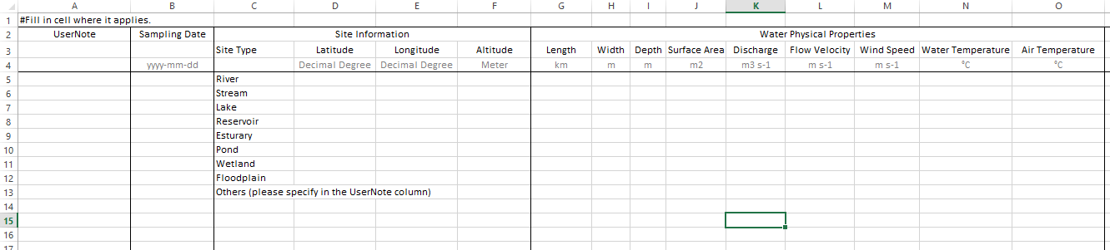
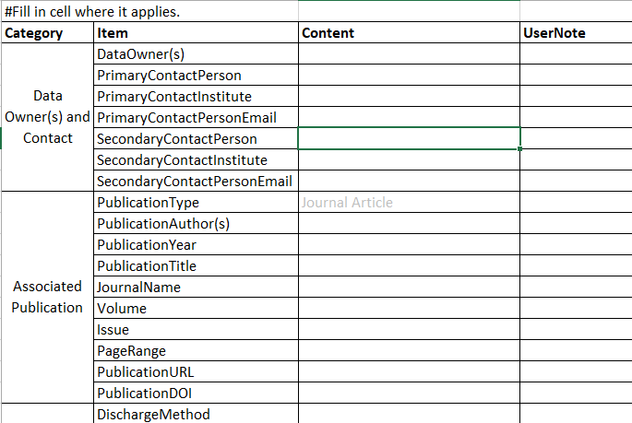
Data Template
UPLOAD DATA
Excel Upload Form
Download Data Upload Template
Download Metadata Upload Template
Upload Data and Metadata
Data.xlsx
Meta.xlsx
Metadata Template
Data Checking
Data Manipulation
Data Storage

Slide 5
UPLOAD DATA
Batch Upload Form
(Select columns and units to build spreadsheet for data input)
Part 1: Site Information
Site Type
Site Location
(stream, river, lake, reservoir, pond, wetland, estuary, floodplain, others)
Longitude
Latitude
Altitude
dec deg
dec deg
masl
deg, min, sec
deg, min, sec
Part 2: Physical Properties
Sampling
Date
Water
Temp
Air
Temp
Width
Depth
Water Surface Area
(lakes, ponds, etc.)
Wind
Speed
(yyyy-mm
-dd)
°C
°C
m
m
m²
m s⁻¹
km
ft
km⁻²
ft s⁻¹
Discharge
Flow Velocity
m s⁻¹
ft s⁻¹
m s⁻¹
L s⁻¹
ft s⁻¹

Slide 6
UPLOAD DATA
Batch Upload Form
(Select columns and units to build spreadsheet for data input)
Part 3: Greenhouse gas concentrations
CO₂
CO₂ method
CH₄
CH₄ method
N₂O
N₂O method
ppm
ppm
ppm
µatm
µatm
µatm
µmol L⁻¹
µmol L⁻¹
µmol L⁻¹
mg C L⁻¹
mg C L⁻¹
µg L⁻¹
mg L⁻¹
mg L⁻¹
mg L⁻¹
Part 4: Greenhouse gas fluxes
CO₂ flux
CO₂ flux method
CH₄ flux
CH₄ flux method
N₂O flux
N₂O flux method
g C m⁻² yr⁻¹
g m⁻² yr⁻¹
g m⁻² yr⁻¹
mg C m⁻² d⁻¹
mg m⁻² d⁻¹
mg m⁻² d⁻¹
mg C m⁻² hr⁻¹
mg m⁻² hr⁻¹
mg m⁻² hr⁻¹
µg C m⁻² d⁻¹
µg m⁻² d⁻¹
µg m⁻² d⁻¹
g C m⁻² d⁻¹
g m⁻² d⁻¹
g m⁻² d⁻¹
…
…
…

Slide 7
UPLOAD DATA
Batch Upload Form
(Select columns and units to build spreadsheet for data input)
Part 5: Gas transfer velocity
k₆₀₀-CO₂
k-CO₂
k₆₀₀-CH₄
k-CH₄
k₆₀₀-N₂O
k-N₂O
m d⁻¹
m d⁻¹
m d⁻¹
m d⁻¹
m d⁻¹
m d⁻¹
cm s⁻¹
cm s⁻¹
cm s⁻¹
cm s⁻¹
cm s⁻¹
cm s⁻¹
Part 6: Other in situ measurements
DOC
POC
TOC
pH
Alkalinity
DO
Chl a
mg L⁻¹
mg L⁻¹
mg L⁻¹
100 mg CaCO3
mg L⁻¹
µg L⁻¹
µmol L⁻¹
µmol L⁻¹
µmol L⁻¹
µmol L⁻¹
%Sat
Next
Specify total number of observations
Total number of observations
GENERATE SPREAD TABLE

Slide 8
UPLOAD DATA
Batch Upload Form
Spreadsheet generated for data input
Adjust
Column
Sequence
2
1
…
…
Column 1 | Column 2 | … | Column …
unit | unit | unit | unit
data | data | data | data
data | data | data | data
data | data | data | data
Column sequence can be adjusted by giving sequence number
Submit button will send data to backend database
SUBMIT

Slide 9
Work done during UW’s geohackweek
preliminary database model
site location (database table): site type, longitude, latitude, altitude, point
measurements (database table): date, site location, measurement type, unit, measurement
data written into the database
exploratory data analysis:
Interactive Time Series https://geohackweek.github.io/ghw2018_web_portal_inlandwater_co2/InteractiveTimeSeries.html
Marker Clustering https://geohackweek.github.io/ghw2018_web_portal_inlandwater_co2/MarkerClustering.html
Data Analysis https://github.com/geohackweek/ghw2018_web_portal_inlandwater_co2/blob/master/notebooks/Exploratory%20Data%20Analysis.ipynb
github repository: https://github.com/geohackweek/ghw2018_web_portal_inlandwater_co2

Slide 10
Moving forward …
Two directions: refining the database model & developing frontend views
Database model
whole dataset containing data from multiple papers versus datasets from single papers
data checking process: file format, using templates or not, units and conversion, dealing with different datetime formats, measurements other than co2, etc.
Developing frontend views
see next page …

Slide 11
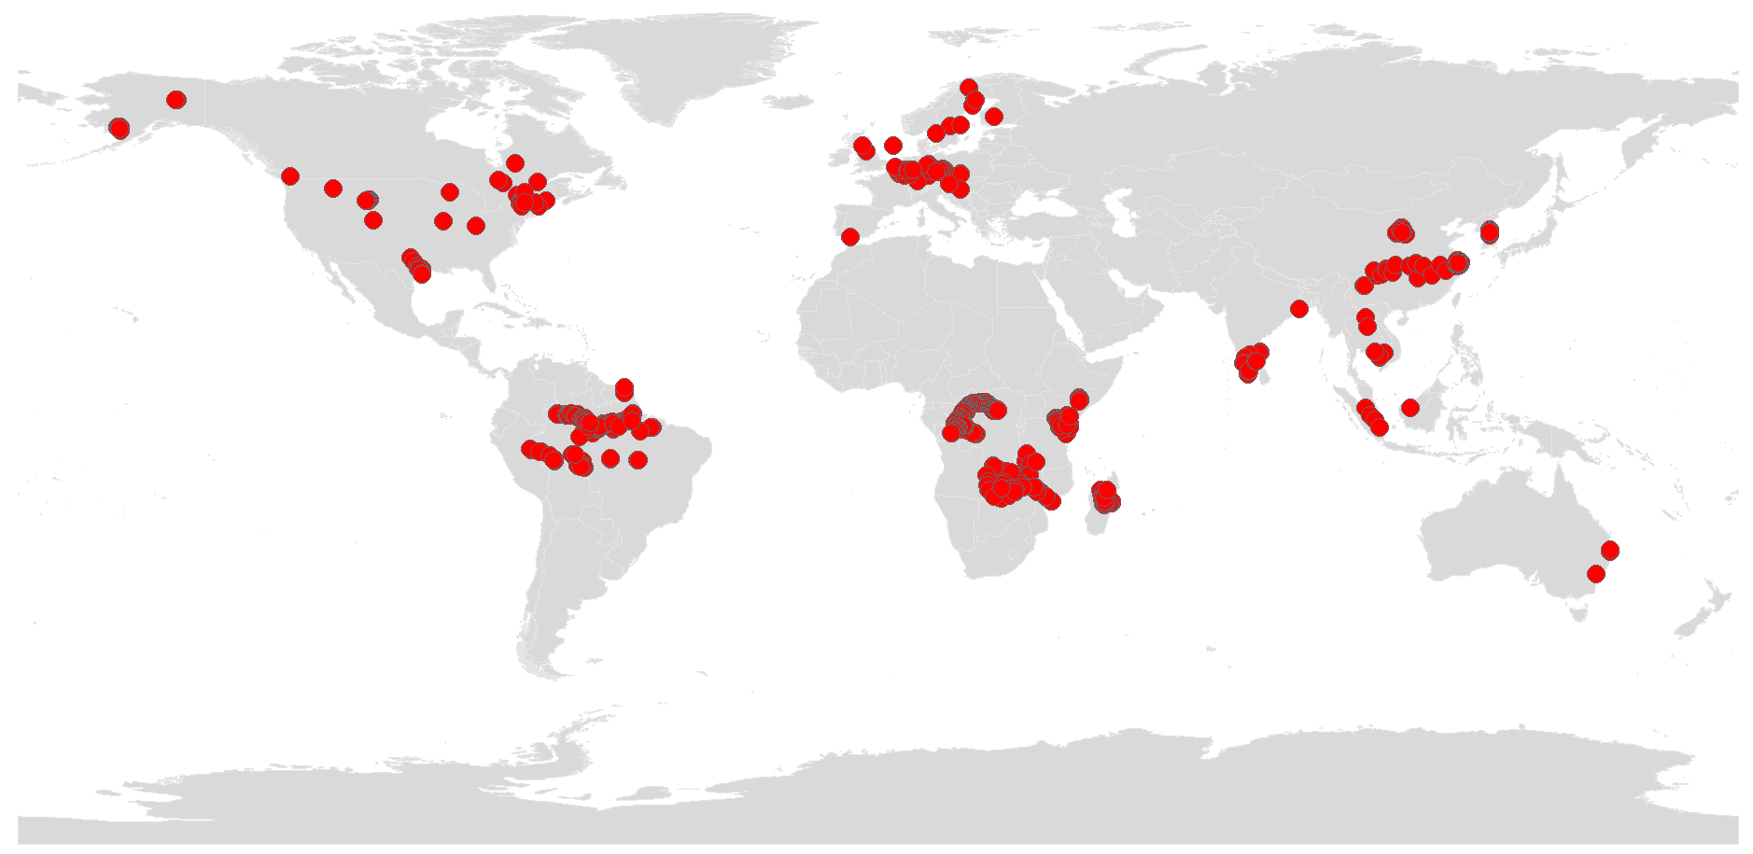
Moving forward …
Developing frontend views
View for displaying static site locations (using interactive world map for background; having functionalities like changing symbol size or color, etc.)
View for displaying site location marker clustering
View for displaying total measurements at each site location
View for displaying CO₂ measurements at one site as time series (symbol size)
View for displaying all CO₂ measurements
the home page view, the excel file uploading view, downloading template view, batch uploading views…

Slide 12
Not sure …
having another database in a separate docker container (two databases: one having data ready in it and for developing different views, the other for refining the database model)
Branching into to sub-directions (refining the database model and developing views), and request pull
…

Slide 13
web hosting services
What cloud services?
Other options for website hosting?
A later step? I can develop the website on my own machine then upload to a server?

Slide 14
tools
front-end tools: html, css, javascript
back-end tools: mysql, python, etc.
webdev framework: django, …
web browsers: firefox, google chrome, …

Slide 15
UPLOAD DATA
Single Upload Form
(Input data, select units, click save and submit to submit data)
Part 1: Site Information
Site Coordinate
Site Type
Longitude
unit
Latitude
unit
Altitude
unit
stream
river
lake
reservoir
pond
estuary
…
dec deg
deg, min, sec
dec deg
deg, min, sec
masl
SAVE
View Site on Map
Part 2: Physical Properties
Sampling Date
yyyy-mm-dd
Water Temp
unit
Air Temp
unit
Depth
unit
Width
unit
°C
°C
m
ft
m
km
Waterbody
Surface Area (lakes, ponds, etc)
unit
Wind Speed
unit
Discharge
unit
Flow Velocity
unit
m²
km²
m s⁻¹
ft s⁻¹
m³ s⁻¹
ft³ s⁻¹
L s⁻¹
m s⁻¹
ft s⁻¹
SAVE

Slide 16
UPLOAD DATA
Single Upload Form
(Input data, select units, click save and submit to submit data)
Part 3: Greenhouse gas concentrations
CO₂
unit
CO₂ Method
CH₄
unit
CH₄ Method
N₂O
unit
N₂O Method
ppm
µatm
µmol L⁻¹
mg C L⁻¹
mg L⁻¹
GC
FTIR
…
ppm
µatm
µmol L⁻¹
mg C L⁻¹
mg L⁻¹
GC
FTIR
…
ppm
µatm
µmol L⁻¹
µg L⁻¹
mg L⁻¹
GC
FTIR
…
SAVE
Part 4: Greenhouse gas fluxes
CO₂ Flux
unit
CO₂ Flux Method
CH₄ Flux
unit
CH₄ Flux Method
N₂O Flux
unit
N₂O Flux Method
g C m⁻² yr⁻¹
g C m⁻² d⁻¹
mg C m⁻² hr⁻¹
µg C m⁻² d⁻¹
g C m⁻² d⁻¹
Floating Chamber
…
g m⁻² yr⁻¹
g m⁻² d⁻¹
mg m⁻² hr⁻¹
µg m⁻² d⁻¹
g m⁻² d⁻¹
Floating Chamber
…
g m⁻² yr⁻¹
g m⁻² d⁻¹
mg m⁻² hr⁻¹
µg m⁻² d⁻¹
g m⁻² d⁻¹
Floating Chamber
…
SAVE

Slide 17
UPLOAD DATA
Single Upload Form
(Input data, select units, click save and submit to submit data)
Part 5: Gas transfer velocity
k₆₀₀-CO₂
unit
k-CO₂
unit
k₆₀₀-CH₄
unit
k-CH₄
unit
k₆₀₀-N₂O
unit
k-N₂O
unit
m d⁻¹
cm s⁻¹
m d⁻¹
cm s⁻¹
m d⁻¹
cm s⁻¹
m d⁻¹
cm s⁻¹
m d⁻¹
cm s⁻¹
m d⁻¹
cm s⁻¹
SAVE
Part 6: Other in situ measurements
DOC
unit
POC
unit
TOC
unit
pH
unit
Alkalinity
unit
mg L⁻¹
µmol L⁻¹
mg L⁻¹
µmol L⁻¹
mg L⁻¹
µmol L⁻¹
mg CaCO₃
µmol L⁻¹
DO
unit
Chl a
unit
mg L⁻¹
µg L⁻¹
SAVE
SUBMIT

Slide 18
UPLOAD DATA
MAP INTERFACE
Batch Upload
Single Upload
CSV/MS file
VIEW DATA
CO₂
CH₄
N₂O
Streams
DOWNLOAD DATA
Filter by
Location
Adjust Symbol Size
Choose Color Ramp
Date Range
Color Ramp
Gas Type
Min
Max
…

